Slide 1






AI ITap 2026
Building digital literacy and critical thinking
Contacts:
AI Lead - Simon Lea (S.p.lea1@ljmu.ac.uk)
AI Team - Sarah Gleave (S.J.Gleave@ljmu.ac.uk)
AI Team - Mike Martin (M.C.Martin@ljmu.ac.uk)
Key:
Student Slides
Mentor Slides
Both

Slide 2

Contents
Slide Number
03
Rationale
04
CARE Framework
05
Student University Experience
06-07
Student Evidence
08-09
Literature reflections
10
School - Based Summary
11-15
Student School-Based Evidence
16
Mentor Question Prompts
10
Mentor Questions
17-18
Mentor Assessment Document
19
Post-School Evidence
Student Day 5 Evidence

Slide 3

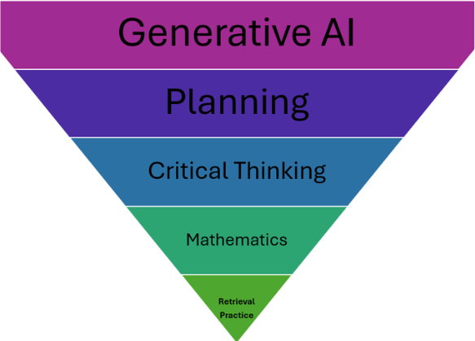


Rationale
Ofsted (2024) acknowledge the broad availability of AI, and they support its innovation in improving education for learners. They state how they as an organisation have embraced and are harnessing some the features of AI within their own processes. Ofsted will assess the impact of the use of AI on learners as part of inspections.
In the ever-increasing digital age, with AI becoming a regular feature within schools up and down the country, LJMU is seeking to take a proactive, innovative and ethical approach to how AI can be best utilised by our student teachers. The use of AI, and more specifically large language models (LLM), such as Google Gemini allows the student teacher and mentor to interact with an AI tool that can provide information, make suggestions, critique ideas and generate content based on the input it receives. At the heart of the ITaP is developing student teachers’ digital literacy skills, decision making and strengthening their professional judgement skills. Despite the AI being able to provide output and assist in idea generation, the ultimate decisions and creative control remains with the teachers. Through working closely with the mentor, the student teacher will maintain autonomy, accountability and agency through crafting careful prompts. Through rigorous analysis and professional reflection, the AI has the potential to be a valuable part of the teacher toolkit.
The DfE (2025) recognises that when used appropriately, AI has the potential to reduce workload, free up teachers’ time and thus allowing them to focus on face-to-face teaching. The DfE has identified several ways that AI could support teachers, including, creating educational resources, lesson and curriculum planning, tailored feedback, revision activities, administrative tasks and supporting personalised learning. Despite these potential benefits, the DfE are keen to impress upon educators that careful steps need to be taken to ensure effective use due to possible inaccuracies, unsafe and biased content and unreliable outputs.

Slide 4






CARE FRAMEWORK
EXTERNAL-FACING CHECKPOINT
Have I checked whether the use of Gen AI aligns with my school’s policies on technology, data protection, and safeguarding?
Governance & Compliance
Is this Gen AI tool educationally sound, age-appropriate, suitable for the subject and aligned with the National Curriculum?
Pedagogical suitability
Am I using Gen AI in a way that respects student autonomy, academic integrity, and professional transparency?
Ethical Professionalism
INTERNAL-FACING CHECKPOINT
Rework
Rethink
Reprompt
Reflect upon own subject expertise and consider your own initial ideas.
Recognise the subtle subject specific considerations?
What pedagogical challenge or opportunity is prompting you to explore Gen AI?
What outcome would success look like?
Reject
C
A
R
E
COLLECT
ARTICULATE
REVIEW
EXPLORE
Accept
Gather essential context before engaging Gen AI:
*Student needs
Curriculum requirements
Learning objectives
*Prior assessments/ knowledge
Your subject expertise
* Be aware of data protection and safeguarding obligations
Craft clear, specific prompts that reflect:
Pedagogical intent
Defining the task explicitly
Specifying format
Give the Gen AI a role and context
Examples and non-examples
Embed your own thinking
Evaluate outputs against:
Accuracy
Age-appropriateness
Curriculum alignment
Potential bias
Pedagogical value
Evaluate how the outputs aligns with your original thinking and expectations
.
Based on your review, decide to
A) Accept and use
B Reject entirely
C) Reprompt- Consider adjusting the
specificity, such as
Add clearer parameters, constraints, or success criteria.
Add more context and/or examples.
Respecify structure and audience in clearer wording.
UNDERPINNED BY TEACHER KNOWLEDGE, CRITICAL THINKING AND JUDGEMENT
$© Simon Lea 2026$

Slide 5

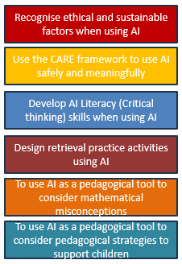
University: Student Experience
ITaP Outcomes
Day 1
Day 1
Day 1
Ethical Use of AI
Benefits & Limitations
The CARE Framework
INTRODUCE, ANALYSE, PREPARE
Day 2
Day 2
Day 2
Retrieval Practice
Misconceptions & Pedagogical Strategies
Approximations of Practice
ANALYSE, PREPARE, ENACT, ASSESS

Slide 6

Student Evidence
Teacher
I can teach online thanks to training from Ingoude.
Student
EduFauget connects our students with great mentors.
Learning through Borcelle Digital makes me more enthusiastic.”

Slide 7
Student Evidence
Teacher
I can teach online thanks to training from Ingoude.
Student
EduFauget connects our students with great mentors.
Learning through Borcelle Digital makes me more enthusiastic.”

Slide 8

Reflection on the literature
Authors
Key takeaways

Slide 9
Reflection on the literature
Authors
Key takeaways

Slide 10


School-Based Evidence
Wed
Wed
Thurs
Thurs
11th
11th
12th
12th
School-based discussions
School-based observations
Lesson Plan and design
Lesson Feedback
Our vision is to make quality education the new standard, not the exception.

Slide 11
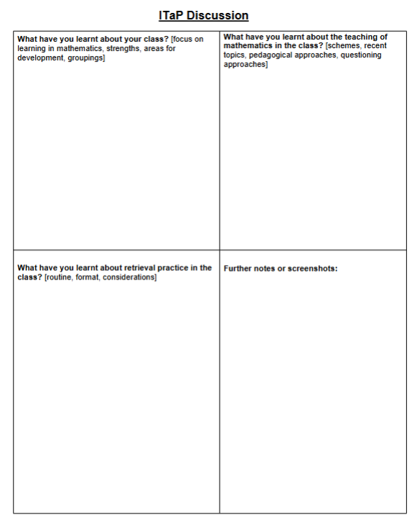
School-Based Evidence (Wed)
Our vision is to make quality education the new standard, not the exception.

Slide 12
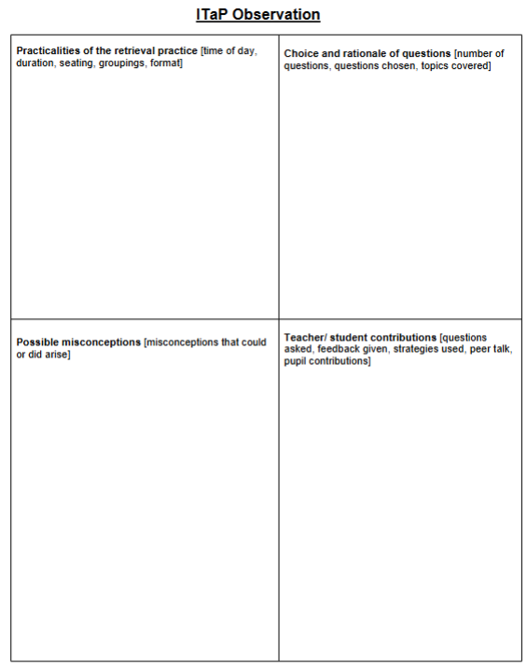
School-Based Evidence (Wed)
Our vision is to make quality education the new standard, not the exception.

Slide 13
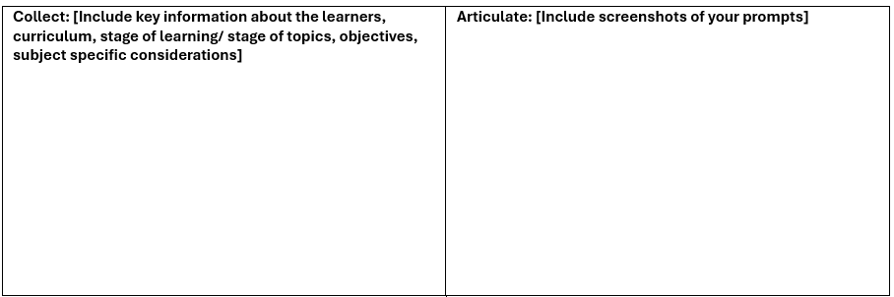
School-Based Evidence (Wed)
Our vision is to make quality education the new standard, not the exception.

Slide 14
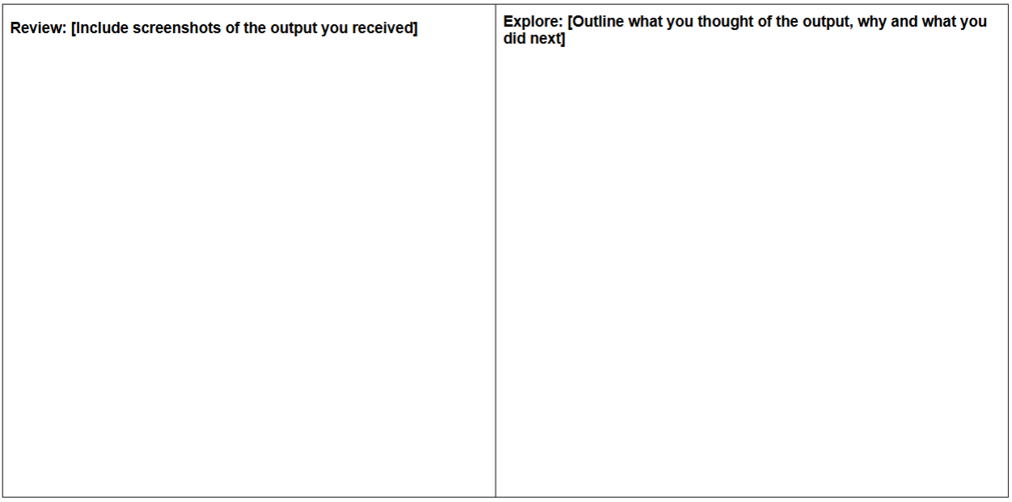
School-Based Evidence (Wed)
Our vision is to make quality education the new standard, not the exception.

Slide 15
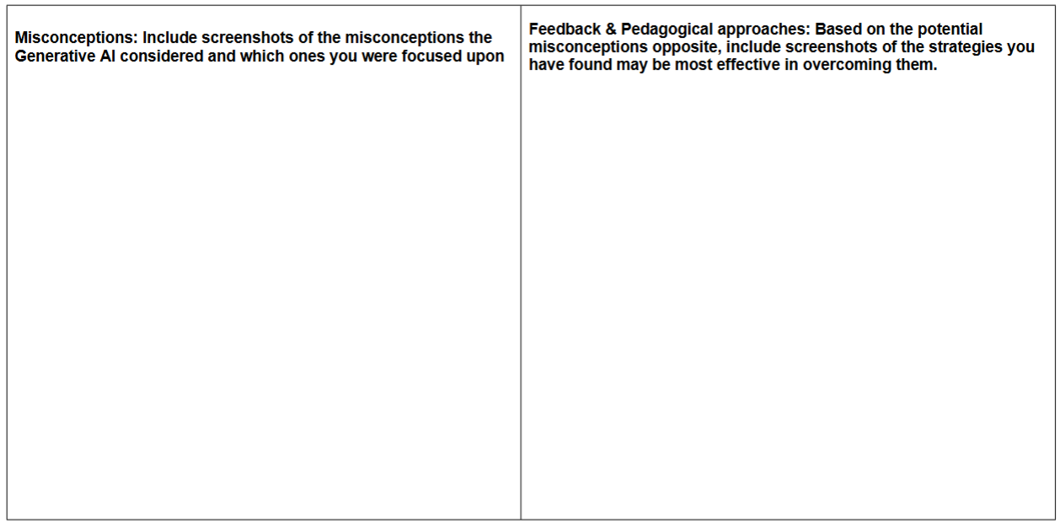
School-Based Evidence (Weds)
Our vision is to make quality education the new standard, not the exception.

Slide 16

Mentor Questions
“What were the key elements within your initial prompt to AI?”
Helps check understanding of the CARE framework and how teacher knowledge and agency underpins any AI output.
“Which part of this activity was suggested by AI, and which part did you have to change to make it work for this specific class?“
Helps check critical evaluation and adaptation skills.
"How did you ensure the mathematical approaches in this activity matches the way I taught them earlier in the week?"
Helps evaluate professional alignment and accuracy.
"If you had to do this again without AI, what core 'retrieval' principles would you keep?"
Evaluates understanding of the underlying pedagogy (Retrieval Practice) versus the tool.

Slide 17
Mentor Assessment Form
Please mark the appropriate coloured box on the right-hand side for each assessment outcome and write a brief comment to explain why you came to this decision
The student teacher has gathered key information about the class, the curriculum coverage and other necessary information.
Comments:
The student can use AI to augment their own thinking and critically evaluate the retrieval activity to ensure it meets the specific cognitive and mathematical needs of the learners in their placement class
Comments:
The chosen activity was suitable in age/stage, format and challenge.
Comments:
Contact us:

Slide 18
Mentor Assessment Form
Please mark the appropriate coloured box on the right-hand side for each assessment outcome and write a brief comment to explain why you came to this decision
The student teacher was aware of and planned for potential misconceptions.
Comments:
The student teacher was capable of addressing misconceptions confidently.
Comments:
The planning & delivery of the retrieval practice was well organised and professional
Comments:
Contact us:

Slide 19


University- Based Evidence (Friday)
Building on from what I have learnt

